Slide 1

Competitive Programming
Code Club - 9/25/23

Slide 2
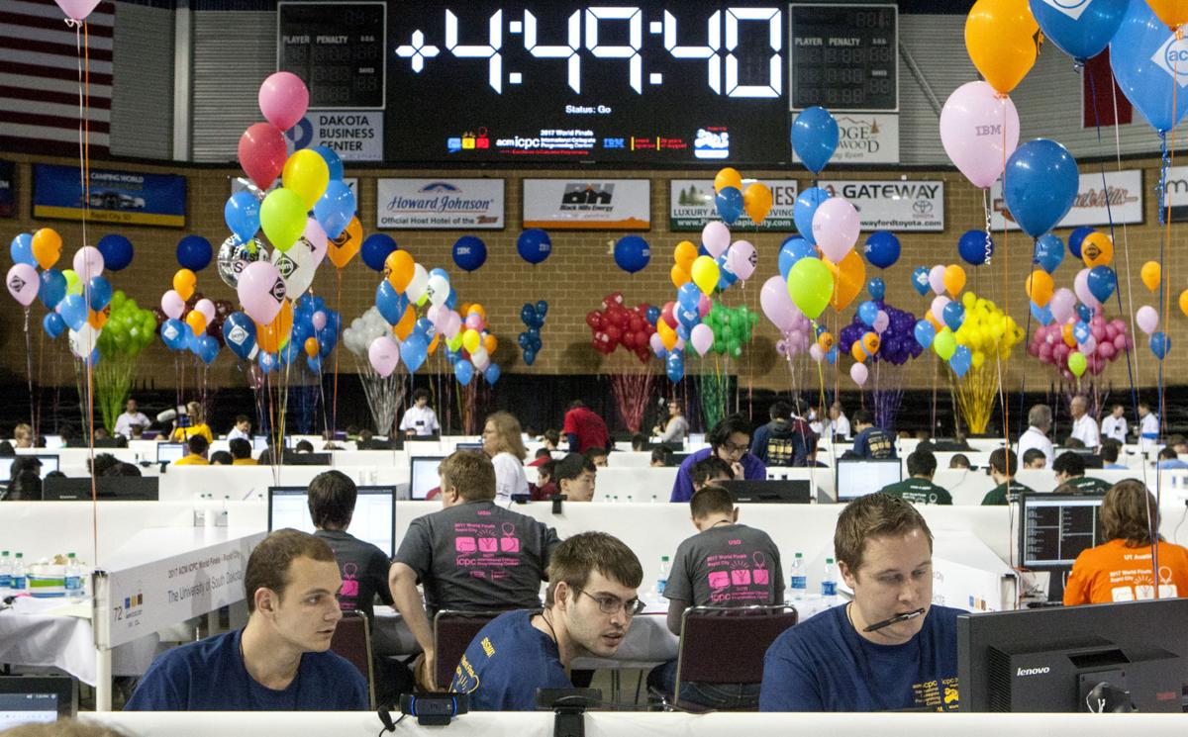
What is competitive programming?
Programming, but fast!
C++ or Python
Mainly about learning different data
structures (i.e. arrays) or
algorithms (i.e. dijkstra's algorithm)

Slide 3
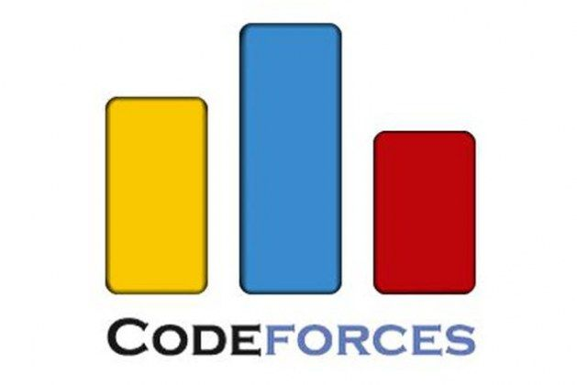


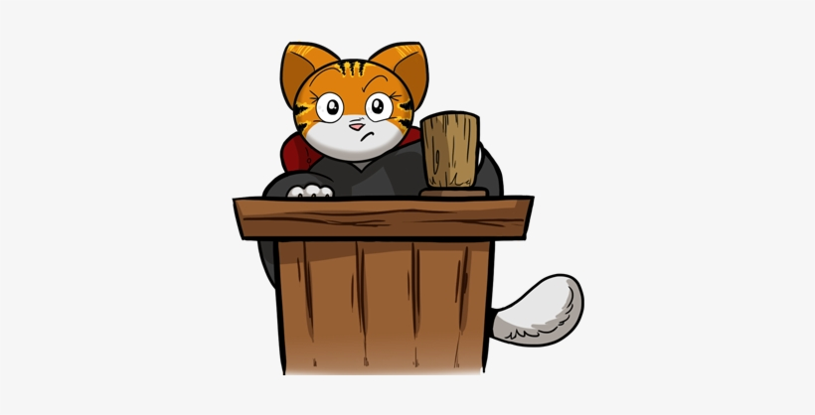
Why do competitive programming?
Prizes!
Great technical interview prep
Resume booster
Trains problem solving skills

Slide 4
Start coding!
https://open.kattis.com/contests/hnf8ku

